Slide 1

Chapter 5: CPU Scheduling
Operating System Concepts – 10th Edition
Silberschatz, Galvin and Gagne ©2018

Slide 2
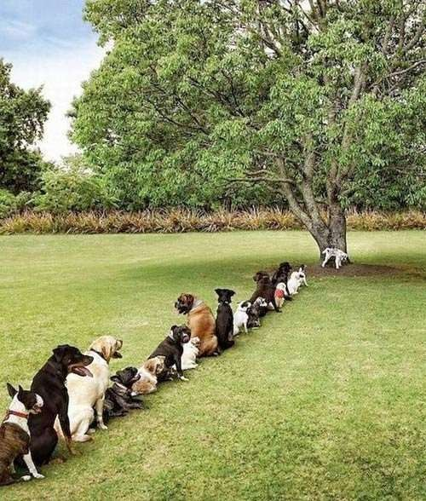
Outline
Basic Concepts
Scheduling Criteria
Scheduling Algorithms
Algorithm Evaluation
Operating System Concepts – 10th Edition
Silberschatz, Galvin and Gagne ©2018

Slide 3
Objectives
Describe various CPU scheduling algorithms
Assess CPU scheduling algorithms based on scheduling criteria
Apply modeling and simulations to evaluate CPU scheduling algorithms
Operating System Concepts – 10th Edition
Silberschatz, Galvin and Gagne ©2018

Slide 4

Scheduling
An OS must allocate resources amongst competing processes.
The resource provided by a processor is execution time.
The resource is allocated by means of scheduling
determines which processes will wait and which will progress.
The aim of processor scheduling is to assign processes to be executed by the processor over time, in a way that meets system objectives:
response time, throughput, and processor efficiency.
Operating System Concepts – 10th Edition
Silberschatz, Galvin and Gagne ©2018

Slide 5
Scheduling Objectives
The scheduling function should
Share time fairly among processes
Prevent starvation of a process
Use the processor efficiently
Have low overhead
Prioritise processes when necessary (e.g. real time deadlines)
Operating System Concepts – 10th Edition
Silberschatz, Galvin and Gagne ©2018

Slide 6
Types of Scheduling
Long-term scheduling is performed when a new process is created.
This is a decision whether to add a new process to the set of processes that are currently active.
Medium-term scheduling is a part of the swapping function.
This is a decision whether to add a process to those that are at least partially in main memory and therefore are available for execution.
Short-term scheduling is the actual decision of which ready process to execute next. Known as the dispatcher.
Long-term scheduling
The decision to add to the pool of processes to be executed
Medium-term scheduling
The decision to add to the number of processes that are partially or fully in main memory
Short-term scheduling
The decision as to which available process will be executed by the processor
I/O scheduling
The decision as to which process's pending I/O request shall be handled by an available I/O device
Operating System Concepts – 10th Edition
Silberschatz, Galvin and Gagne ©2018

Slide 7



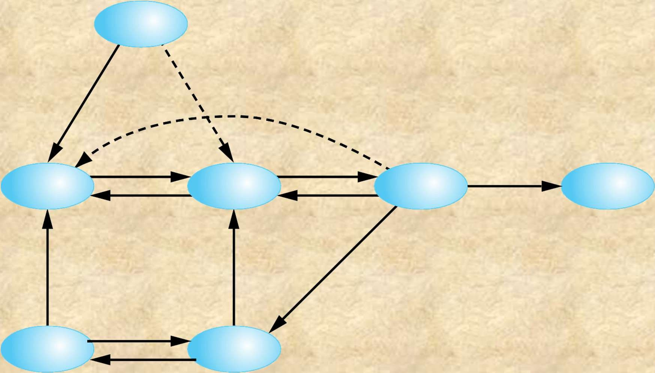



New
Ready/ Suspend
Activate
Dispatch
Release
Ready
Running
Exit
Suspend
Timeout
Event
Occurs
Event
Occurs
Activate
Blocked/ Suspend
Blocked
Suspend
(b) With Two Suspend States
Figure 3.9 Process State Transition Diagram with Suspend States
© 2017 Pearson Education, Inc., Hoboken, NJ. All rights reserved.

Slide 8
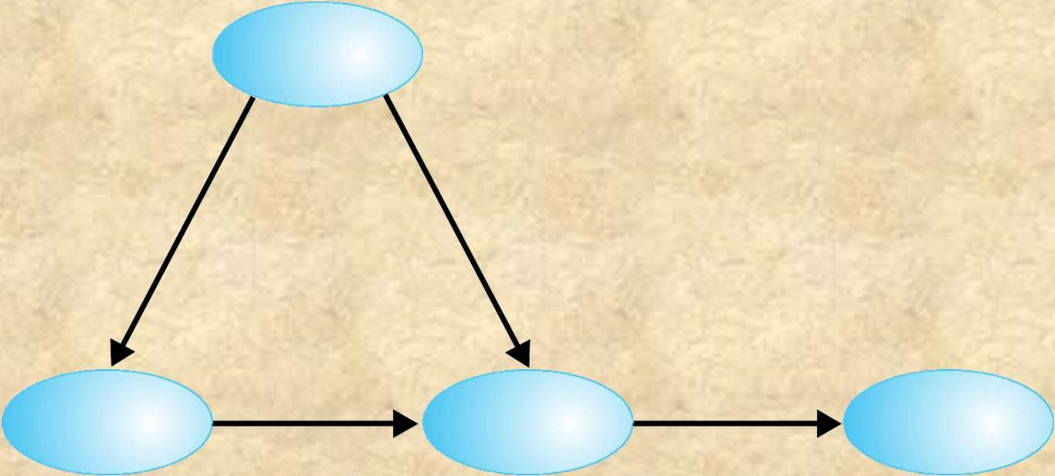


New
Long-term
Long-term
scheduling
scheduling
Ready/ Suspend
Ready
Running
Exit
Medium-term scheduling
Short-term scheduling
Blocked/ Suspend
Blocked
Medium-term scheduling
Figure 9.1 Scheduling and Process State Transitions
© 2017 Pearson Education, Inc., Hoboken, NJ. All rights reserved.

Slide 9

Running
Ready
Blocked
Short Term
Blocked, Suspend
Ready, Suspend
Medium Term
Long Term
New
Exit
Figure 9.2
Levels of Scheduling
© 2017 Pearson Education, Inc., Hoboken, NJ. All rights reserved.

Slide 10

Long-term scheduling
Time-out
Batch jobs
Ready Queue
Short-term
Release
scheduling
Processor
Medium-term scheduling
Interactive users
Ready, Suspend Queue
Scheduling is a matter of managing queues to minimize queuing delay and to optimize performance.
Medium-term scheduling
Blocked, Suspend Queue
Blocked Queue
Event Wait
Event Occurs
Figure 9.3
Queuing Diagram for Scheduling
© 2017 Pearson Education, Inc., Hoboken, NJ. All rights reserved.

Slide 11





Long-Term Scheduler
Determines which programs are admitted to the system for processing
Creates processes from the queue when it can, but must decide:
Controls the degree of multiprogramming
The more processes that are created, the smaller the percentage of time that each process can be executed
May limit to provide satisfactory service to the current set of processes
When the operating system can take on one or more additional processes
Which jobs to accept and turn into processes
First come, first served
Priority, expected
execution time, I/O
requirements
© 2017 Pearson Education, Inc., Hoboken, NJ. All rights reserved.

Slide 12
Medium-Term Scheduling
Part of the swapping function
Swapping-in decisions are based on the need to manage the degree of multiprogramming
Considers the memory requirements of the swapped-out processes
© 2017 Pearson Education, Inc., Hoboken, NJ. All rights reserved.

Slide 13

Short-Term(CPU) Scheduling
Known as the dispatcher
Executes most frequently (reason to call it short-term scheduling)
Select from among the processes in ready queue, and allocate the CPU to one of them.
Makes the fine-grained decision of which process to execute next
Invoked when an event occurs that may lead to the blocking of the current process or that may provide an opportunity to preempt a currently running process in favor of another
Examples:
Clock interrupts
I/O interrupts
Operating system calls
Signals (e.g., semaphores)

Slide 14
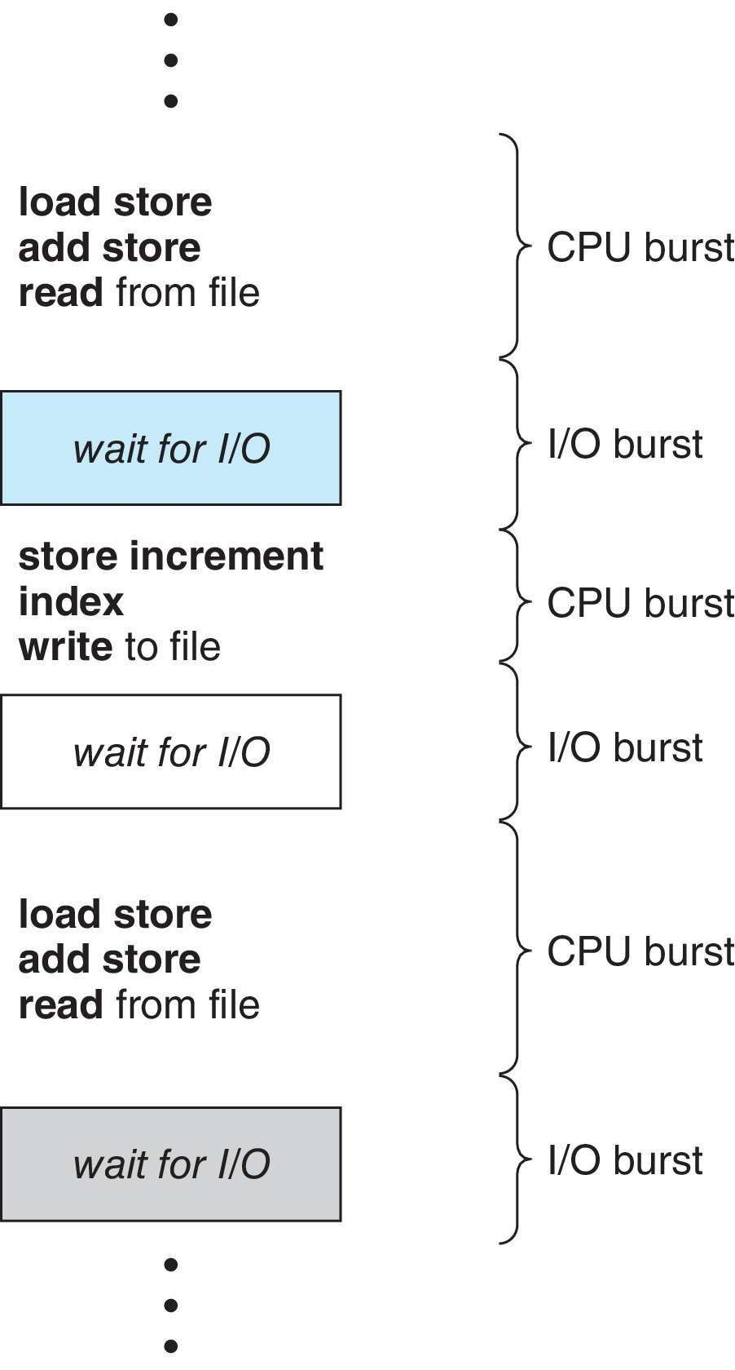
Basic Concepts
Maximum CPU utilization obtained with multiprogramming
CPU–I/O Burst Cycle – Process execution consists of a cycle of CPU execution and I/O wait
CPU burst followed by I/O burst
CPU burst distribution is of main concern
Operating System Concepts – 10th Edition
Silberschatz, Galvin and Gagne ©2018

Slide 15

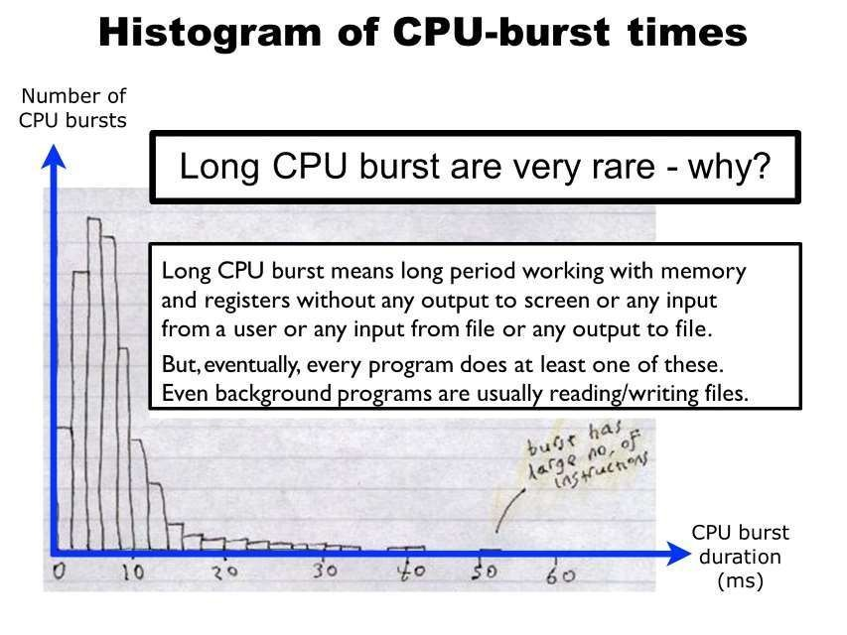

Operating System Concepts – 10th Edition
Silberschatz, Galvin and Gagne ©2018

Slide 16
Non-preemptive vs Preemptive
Proactive Planner
The students who plan their studies, choose their resources wisely, and manage their time effectively, leading to better retention and understanding of material.
By being proactive, these types of students excel in exams and assignments, as they have effectively internalized the material over time rather than cramming or reacting to upcoming deadlines.
Reactive Planner
The students who often react to pressures and deadlines without sufficient planning, which can result in stress and inadequate learning.
As a result they failed to perform well in the exam since they haven't absorbed the material thoroughly.

Slide 17
Nonpreemptive vs Preemptive
Preemptive Scheduling
In preemptive scheduling, the operating system can forcibly suspend (preempt) a currently running process in order to allocate CPU time to another process. This is typically done to ensure that high-priority processes can execute without long waiting times or to maintain responsiveness in a time-sharing environment.
Characteristics:
Higher priority processes can interrupt lower priority ones.
Context switching can occur multiple times between processes.
Typically leads to better responsiveness in interactive systems.

Slide 18
Nonpreemptive vs Preemptive
Non-Preemptive Scheduling
In non-preemptive scheduling, once a process starts its execution, it runs to completion without being interrupted by the operating system. The CPU is not taken away from a running process until it voluntarily yields control, either when it finishes execution or it goes into a waiting state.
Characteristics:
Processes cannot be interrupted; they run to completion.
Simpler to implement since there are fewer context switches.
Can lead to problems such as starvation if high-priority processes keep arriving.

Slide 19
Nonpreemptive vs Preemptive
In preemptive scheduling, the operating system interrupts a currently running process to allocate CPU time to another process that requires immediate attention (often based on priority).
This approach is proactive because it anticipates that certain tasks may need immediate resources, thus ensuring that critical processes do not get delayed.
Example: Consider an operating system that preempts a longer-running process to give CPU time to a high-priority task, such as a user interface response. This proactive behavior ensures that the system remains responsive and efficient, similar to a project manager who reallocates resources to address a critical deadline before it's too late.

Slide 20
Nonpreemptive vs Preemptive
In non-preemptive scheduling, once a process is given the CPU, it runs to completion before another process can take over.
This is reactive because the system waits for the current task to finish before dealing with any new pending tasks, even if those tasks are more urgent.
Example: If a long-running process is scheduled non-preemptively, higher-priority tasks may have to wait until that process completes. This can lead to inefficiencies and system slowdowns, similar to how a manager who waits for problems to manifest before addressing them may find themselves in a crisis situation.

Slide 21
Nonpreemptive vs Preemptive
Nonpreemptive
Once a process is in the running state, it will continue until it terminates or blocks itself for I/O
Preemptive
Currently running process may be interrupted and moved to ready state by the OS
Decision to preempt may be performed when a new process arrives, when an interrupt occurs that places a blocked process in the Ready state, or periodically, based on a clock interrupt

Slide 22
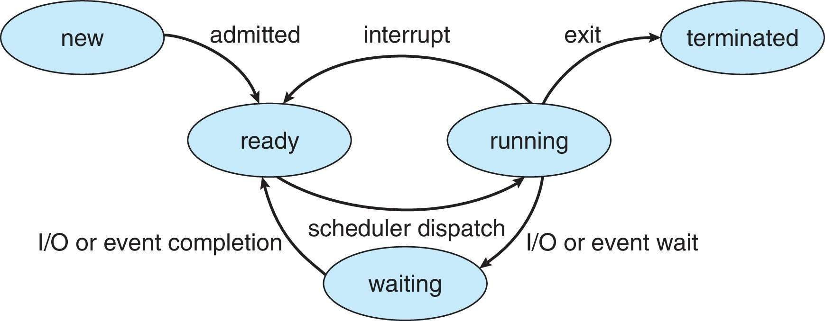
CPU Scheduler
The CPU scheduler selects from among the processes in ready queue, and allocates a CPU core to one of them
Queue may be ordered in various ways
When is CPU scheduler invoked?
CPU scheduling decisions may take place when a process:
Switches from running to waiting state
Switches from running to ready state
Switches from waiting to ready (maybe the process has a higher priority compare to the one is currently running)
Terminates
For situations 1 and 4, there is no choice in terms of scheduling. A new process (if one exists in the ready queue) must be selected for execution.
For situations 2 and 3, however, there is a choice.
Scheduling under 1 and 4 is non-preemptive. It means the process decides to leave the CPU by itself .
All other scheduling is preemptive. It means the OS forces the process to leave the CPU.
Operating System Concepts – 10th Edition
Silberschatz, Galvin and Gagne ©2018

Slide 23
Preemptive and Nonpreemptive Scheduling
When scheduling takes place only under circumstances 1 and 4, the scheduling scheme is nonpreemptive.
Otherwise, it is preemptive.
Under Nonpreemptive scheduling, once the CPU has been allocated to a process, the process keeps the CPU until it releases it either by terminating or by switching to the waiting state.
Virtually all modern operating systems including Windows, MacOS, Linux, and UNIX use preemptive scheduling algorithms.
Operating System Concepts – 10th Edition
Silberschatz, Galvin and Gagne ©2018

Slide 24
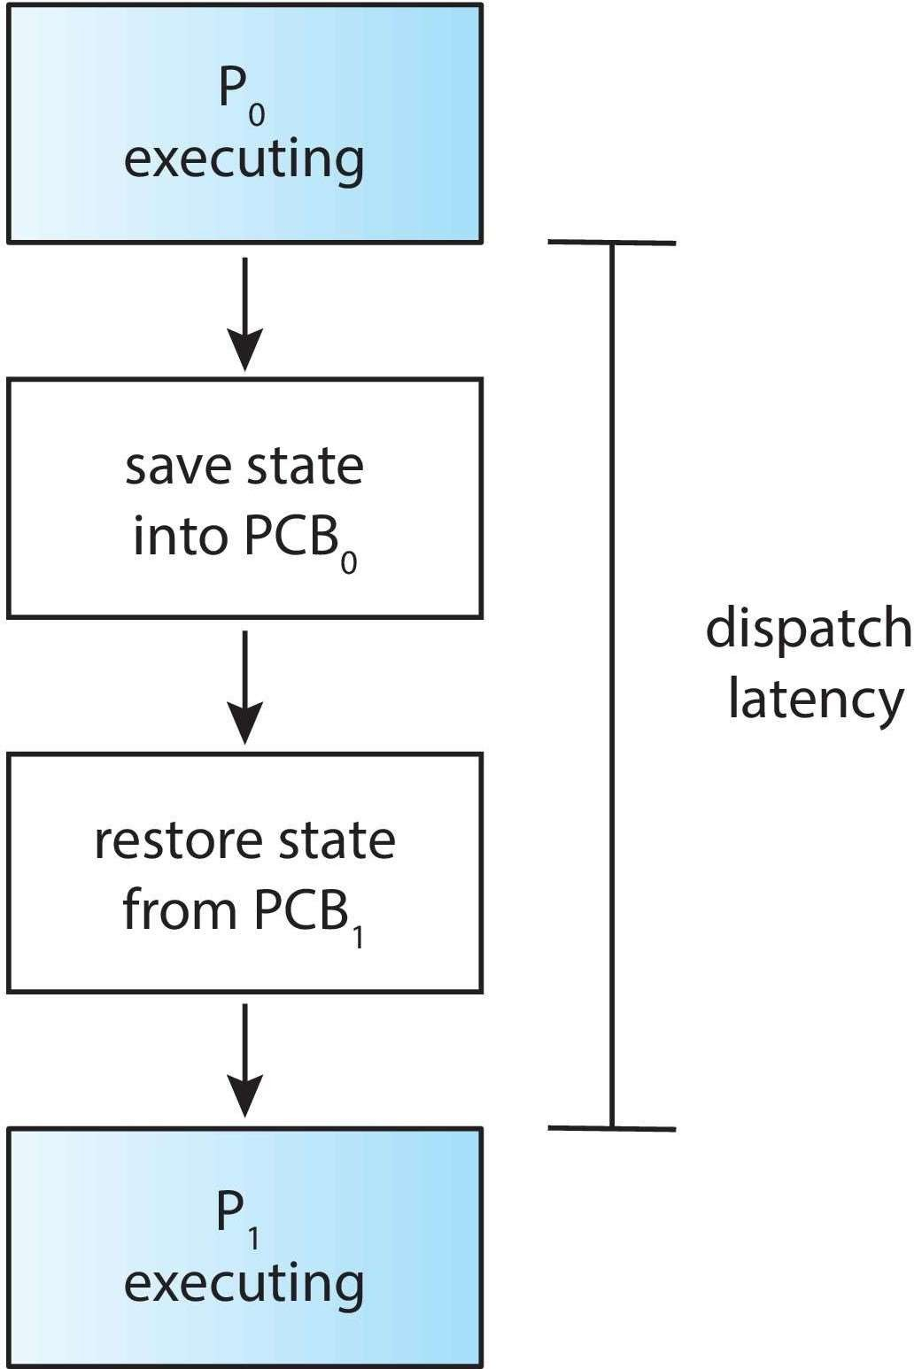
Dispatcher
Dispatcher module gives control of the CPU to the process selected by the CPU scheduler; this involves:
Switching context
Switching to user mode
Jumping to the proper location in the user program to restart that program
Dispatch latency – time it takes for the dispatcher to stop one process and start another running
Operating System Concepts – 10th Edition
5.20
Silberschatz, Galvin and Gagne ©2018

Slide 25
Scheduling Criteria
User oriented:
Turnaround time – amount of time to execute a particular process
Response time – amount of time it takes from when a request was submitted until the first response is produced not output (for time-sharing environment).
Waiting time – amount of time a process has been waiting in the ready queue
System oriented:
CPU utilization – keep the CPU as busy as possible
Throughput – # of processes that complete their execution per time unit
Operating System Concepts – 10th Edition
5.21
Silberschatz, Galvin and Gagne ©2018

Slide 26

Scheduling criteria
Criteria | Definition | Goal
CPU utilization | The % of time the CPU is executing user level process code. | Maximize
Throughput | Number of processes that complete their execution per time unit. | Maximize
Turnaround time | Amount of time to execute a particular process. | Minimize
Waiting time | Amount of time a process has been waiting in the ready queue. | Minimize
Response time | Amount of time it takes from when a request was submitted until the first response is produced. | Minimize
Operating System Concepts – 10th Edition
5.24
Silberschatz, Galvin and Gagne ©2018

Slide 27
Scheduling Algorithms
First Come First Served (FCFS)
Shortest Job First (SJF)
Shortest Remaining Time First (SRTF)
Highest Response Ratio Next (HRRN)
Round Robin (RR)
Virtual Round Robin (VRR)
Multilevel Feedback Queue (MLFQ)
Priority Scheduling (PR)
Multilevel Queue
Operating System Concepts – 10th Edition
5.23
Silberschatz, Galvin and Gagne ©2018

Slide 28

Scheduling algorithms
First Come First Served (FCFS)
Shortest Job First (SJF)
Shortest Remaining Time First (SRTF)
Highest Response Ratio Next (HRRN)
Round Robin (RR)
Virtual Round Robin (VRR)
Multilevel Feedback Queue (MLFQ)
Priority Scheduling (PR)
Multilevel Queue
process termination
ready queue
C PU
I/O event
I/O queue
I/O request
fork a child

Slide 29
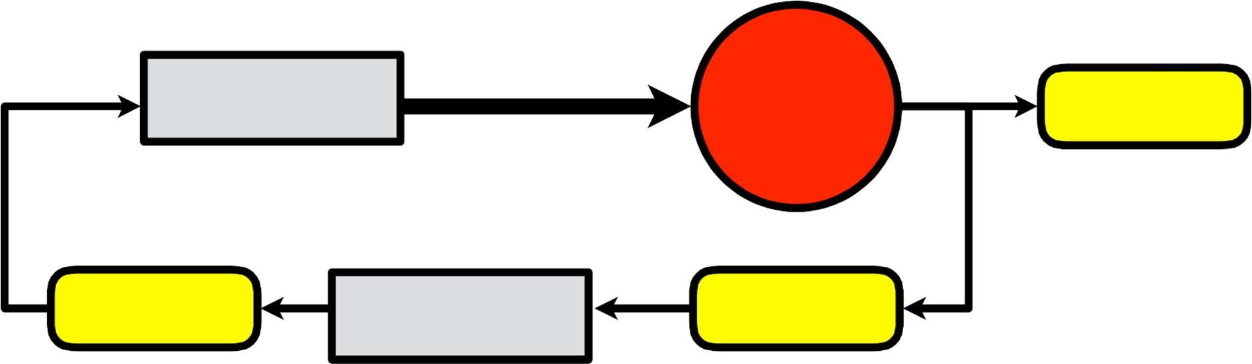
First-Come, First-Served (FCFS)
The first come, first served (commonly called FIFO – first in, first out) process scheduling algorithm is the simplest process scheduling algorithm. Processes are executed on the CPU in the same order they arrive to the ready queue.
ready queue
FC FS
C PU
process
termination
I/O event
I/O queue
I/O request
fork a child
Operating System Concepts – 10th Edition
Silberschatz, Galvin and Gagne ©2018

Slide 30
Arrival Time: Time at which the process arrives in the ready queue. Completion Time: Time at which process completes its execution. Burst Time: Time required by a process for CPU execution.
Turn Around Time: Time Difference between completion time and arrival time. Turn Around Time = Completion Time – Arrival Time
Waiting Time (W.T): Time Difference between turn around time and burst time. Waiting Time = Turn Around Time – Burst Time
Response Time: Time at which the process received its first response.

Slide 31
First- Come, First-Served (FCFS) Scheduling
Process Arrival Time CPU Burst Time
P₁ | 0 | 10
P₂ | 3 | 6
P₃ | 3 | 4
P₄ | 8 | 3
P₅ | 13 | 5
Gantt Chart:
P₁ | P₂ | P₃ | P₄ | P₅
0
10
16
20
23
28
10+13+17+15+15
Avg (Turnaround) Time =
=14
Avg Waiting Time = ⁰⁺⁷⁺¹³⁺¹²⁺¹⁰ =8.4
5

Slide 32
FCFS Scheduling (Cont.)
Advantages:
FCFS is simple and easy
Disadvantages:
FCFS is non-preemptive
FCFS performs much better for long processes(CPU bound) than short ones(I/O bound).
Favors CPU bound processes.
I/O-bound processes have to wait until CPU-bound process completes
Convoy effect - short process behind long process
Consider one CPU-bound and many I/O-bound processes
Operating System Concepts – 10th Edition
5.32
Silberschatz, Galvin and Gagne ©2018

Slide 33




The convoy effect
When using FCFS scheduling, if I/O bound (short CPU burst) processes are scheduled after CPU bound (long CPU burst) processes, the average waiting time increases.
Short CPU burst
Short CPU burst
Long CPU burst

Slide 34
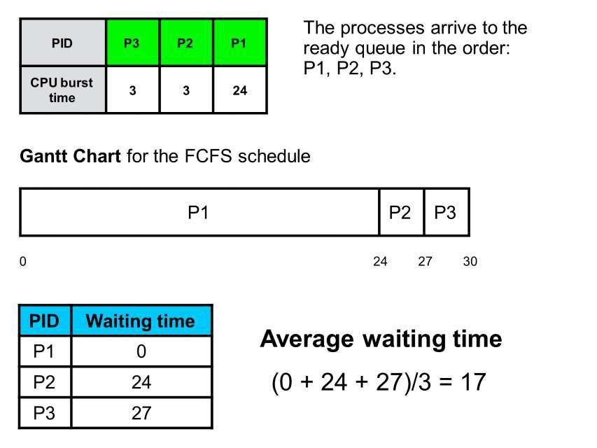

Operating System Concepts – 10th Edition
Silberschatz, Galvin and Gagne ©2018

Slide 35
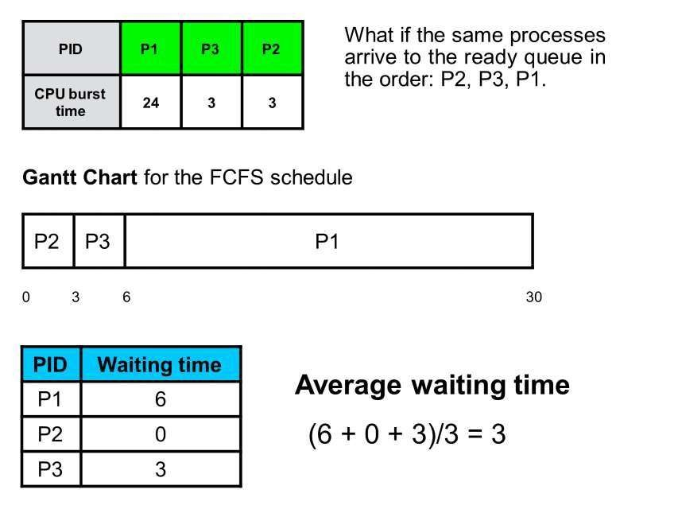
Operating System Concepts – 10th Edition
Silberschatz, Galvin and Gagne ©2018

Slide 36
The convoy effect
When using FCFS scheduling, if I/O bound (short CPU burst) processes are scheduled after CPU bound (long CPU burst) processes, the average waiting time increases.
PID | P3 | P2 | P1
CPU burst time | 3 | 3 | 24
PID | P1 | P3 | P2
CPU burst time | 24 | 3 | 3
Gantt Charts for the FCFS schedules
P1 | P2 | P3
P2 | P3 | P1
0
24 27 30
0 3
6
30
PID | Waiting time
P1 | 0
P2 | 24
P3 | 27
PID | Waiting time
P1 | 6
P2 | 0
P3 | 3
Average waiting time
(0 + 24 + 27) / 3 = 17
Average waiting time
(6 + 0 + 3) / 3 = 3

Slide 37
What is the optimal schedule?
To answer this question we must first define what we mean with optimal.

Slide 38
A better question
What schedule
minimizes the average waiting time?

Slide 39
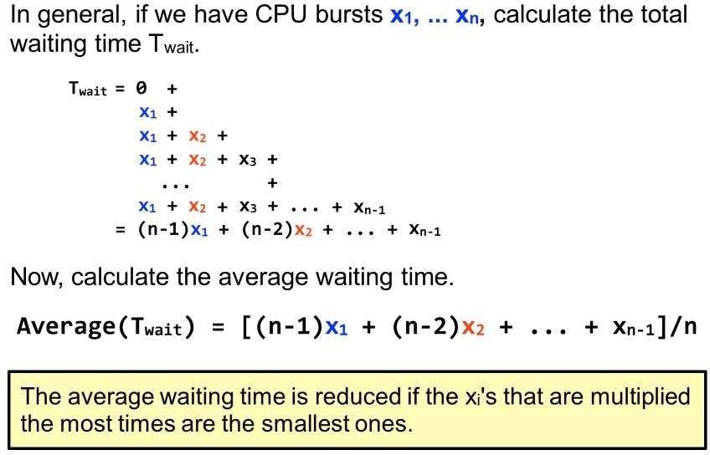

Slide 40
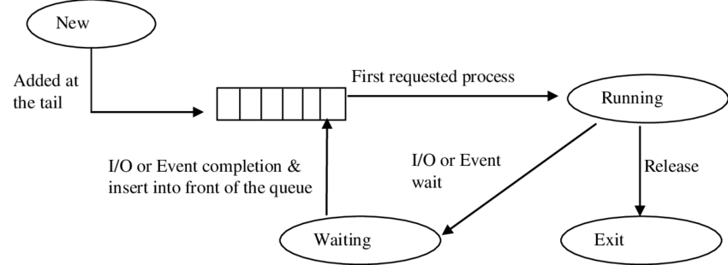

Slide 41
Shortest Job First

Slide 42
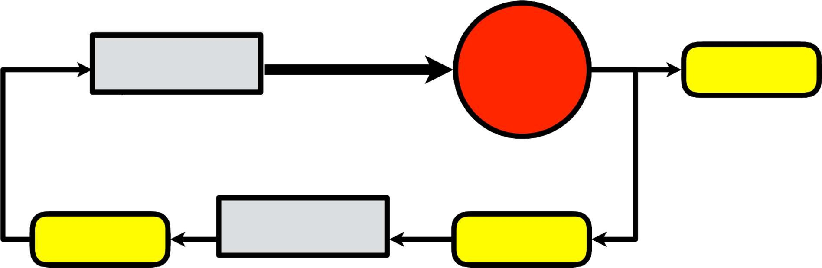
Shortest Job First (SJF)
Shortest Job First (SJF) scheduling assigns the process estimated to complete fastest, i.e, the process with shortest CPU burst, to the CPU as soon as CPU time is available.
ready queue
C PU
process termination
ready queue
SJ F
I/O event
I/O queue
I/O request
fork a child

Slide 43
Shortest-Job-First (SJF) Scheduling
Process with shortest expected processing time is selected next
Short process jumps ahead of longer processes
Non-preemptive policy
Also known as Shortest Process Next (SPN)
SJF is optimal
Gives minimum average waiting time for a given set of processes
Operating System Concepts – 10th Edition
Silberschatz, Galvin and Gagne ©2018

Slide 44
Shortest-Job-First (SJF) Scheduling
Process Arrival Time CPU Burst Time
P₁ | 0 | 10
P₂ | 3 | 6
P₃ | 3 | 4
P₄ | 8 | 3
P₅ | 13 | 5
Gantt Chart:
P₁ | P₄ | P₃ | P₅ | P₂
0
10
13
17
22
28
P1: Starts at 0 and finishes at 10 (0 + 10)
P4: Starts at 10 and finishes at 13 (10 + 3)
P3: Starts at 13 and finishes at 17 (13 + 4)
P5: Starts at 17 and finishes at 22 (17 + 5)
P2: Starts at 22 and finishes at 28 (22 + 6).
Operating System Concepts – 10th Edition
Silberschatz, Galvin and Gagne ©2018

Slide 45
Shortest-Job-First (SJF) Scheduling
Process Arrival Time CPU Burst Time
P₁ | 0 | 10
P₂ | 3 | 6
P₃ | 3 | 4
P₄ | 8 | 3
P₅ | 13 | 5
Turnaround Time = Completion Time−Arrival Time
Operating System Concepts – 10th Edition
Silberschatz, Galvin and Gagne ©2018

Slide 46
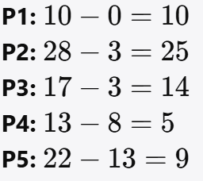
Shortest-Job-First (SJF) Scheduling
Process Arrival Time CPU Burst Time
P₁ | 0 | 10
P₂ | 3 | 6
P₃ | 3 | 4
P₄ | 8 | 3
P₅ | 13 | 5
Turnaround Time = Completion Time−Arrival Time
Operating System Concepts – 10th Edition
Silberschatz, Galvin and Gagne ©2018

Slide 47
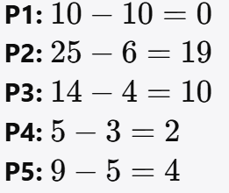
Shortest-Job-First (SJF) Scheduling
Process Arrival Time CPU Burst Time
P₁ | 0 | 10
P₂ | 3 | 6
P₃ | 3 | 4
P₄ | 8 | 3
P₅ | 13 | 5
Waiting Time=Turnaround Time−CPU Burst Time
Avg Waiting Time = ⁰⁺ ¹⁹ ⁺ ¹⁰ ⁺ ² ⁺ ⁴ =7
5
Operating System Concepts – 10th Edition
Silberschatz, Galvin and Gagne ©2018

Slide 48
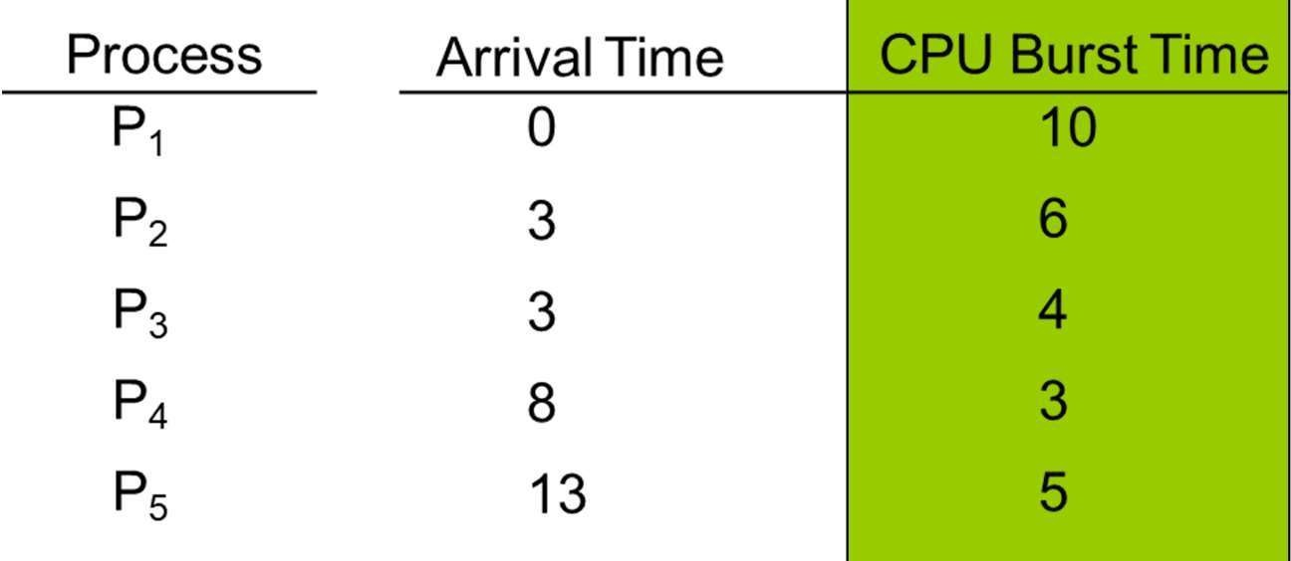
Shortest-Job-First (SJF) Scheduling
Associate with each process the length of its next CPU burst
Use these lengths to schedule the process with the shortest time
SJF is optimal – gives minimum average waiting time for a given set of processes
The difficulty is knowing the length of the next CPU request
Operating System Concepts – 10th Edition
5.40
Silberschatz, Galvin and Gagne ©2018

Slide 49
Shortest-Job-First (SJF) Scheduling
Associate with each process the length of its next CPU burst
Use these lengths to schedule the process with the shortest time
SJF is optimal – gives minimum average waiting time for a given set of processes
Preemptive version called shortest-remaining-time-first
How do we determine the length of the next CPU burst?
Could ask the user
Estimate
Operating System Concepts – 10th Edition
Silberschatz, Galvin and Gagne ©2018

Slide 50
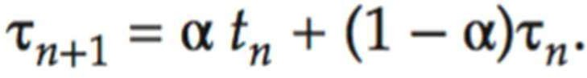




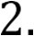




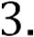
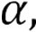


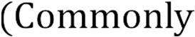

Determining Length of Next CPU Burst
We need to estimate the required processing time (next CPU burst) of each process.
Estimation can be done by using the length of previous CPU bursts, using exponential averaging
n
n+1
th
½
Operating System Concepts – 10th Edition
Silberschatz, Galvin and Gagne ©2018

Slide 51
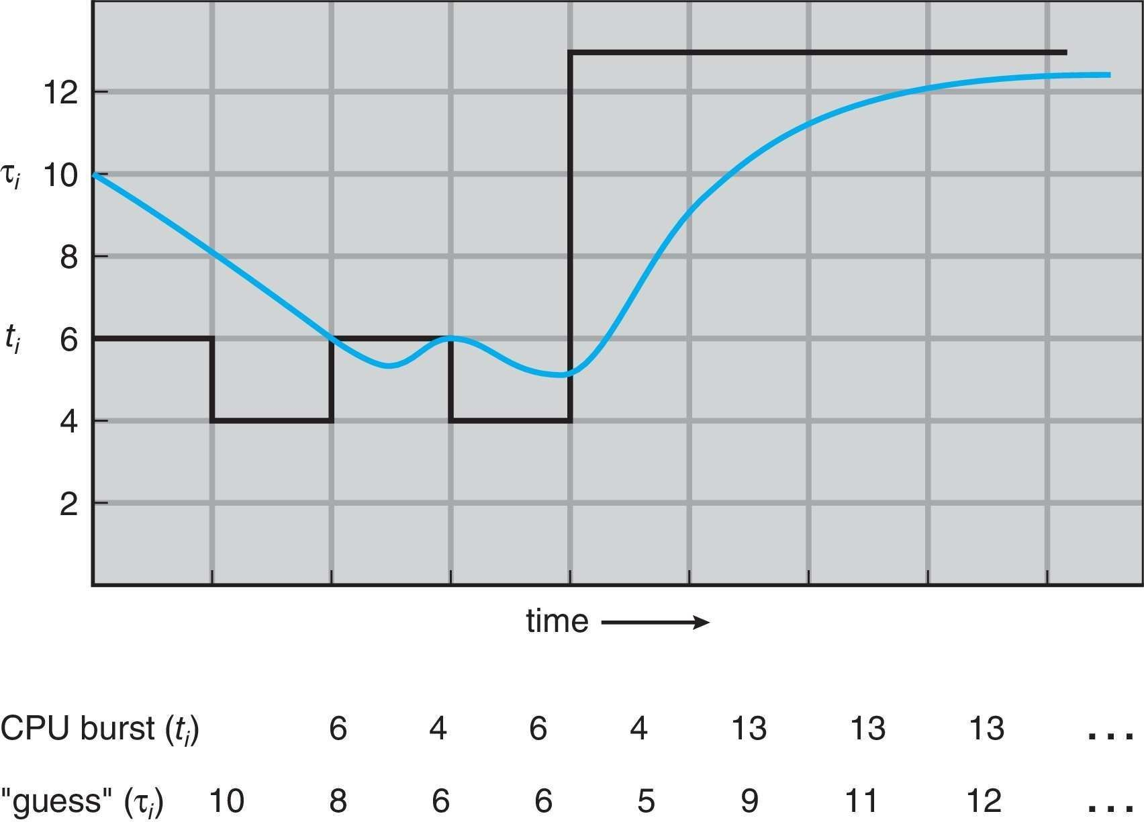
Prediction of the Length of the Next CPU Burst
Operating System Concepts – 10th Edition
Silberschatz, Galvin and Gagne ©2018

Slide 52
Examples of Exponential Averaging
α = 0
^{τ}n+1 ^{= τ}n
Recent history does not count
α =1
•
τ_{n+1} = α t_{n}
Only the actual last CPU burst counts
If we expand the formula, we get:
τ_{n+1} = α t_{n}+(1 - α)α t_{n -1} + …
+(1 - α )^{j} α t_{n -j} + …
+(1 - α )^{n +1} τ₀
Since both α and (1 - α) are less than or equal to 1, each successive term has less weight than its predecessor
Operating System Concepts – 10th Edition
Silberschatz, Galvin and Gagne ©2018

Slide 53
Shortest Remaining Time First (SRTF)
SRTF is the preemptive version of SJF
If the newly arrived process has a shorter running time than what is left of the currently executing process, then the OS will preempt the current process.
Operating System Concepts – 10th Edition
Silberschatz, Galvin and Gagne ©2018

Slide 54
Shortest Remaining Time First (SRTF)
Process Arrival Time CPU Burst Time
P₁ | 0 | 10
P₂ | 3 | 6
P₃ | 3 | 4
P₄ | 8 | 3
P₅ | 13 | 5
Gantt Chart:
P1 | P1 | P1 | P3 | P3 | P3 | P3 | P2 | P2 | P2 | P2 | P2 | P2 | P5 | P5 | P5 | P5 | P5 | P4 | P4 | P4 | P1 | P1 | P1 | P1 | P1 | P1 | P1 | P1
0 | 1 | 2 | 3 | 4 | 5 | 6 | 7 | 8 | 9 | 10 | 11 | 12 | 13 | 14 | 15 | 16 | 17 | 18 | 19 | 20 | 21 | 22 | 23 | 24 | 25 | 26 | 27 | 28
Avg Waiting Time = ¹⁸ ⁺ ⁷ ⁺ ⁰ ⁺ ⁰⁺³ =5.6
5
Operating System Concepts – 10th Edition
Silberschatz, Galvin and Gagne ©2018

Slide 55
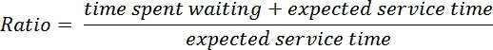
Highest Response Ratio Next (HRRN)
Important SJF and SRTF disadvantage
Possibility of starvation for longer processes
HRRN choose next process with the greatest ratio
A smaller denominator yields a larger ratioso that shorter jobs are favoured,
But aging without service increases the ratio so that a longer process will eventually get past competing shorter jobs.
Non-preemptive policy
Operating System Concepts – 10th Edition
Silberschatz, Galvin and Gagne ©2018

Slide 56
Highest Response Ratio Next (HRRN)
Process |  | Arrival Time | CPU Burst Time
P₁ |  | 0 | 10
P₂ |  | 3 | 6
13/6
17/6
20/6
P₃ P₄ P₅
3
8
13
4
3
5
11/4
5/3
9/3
6/5
9/5
Gantt Chart:
P₁ | P₃ | P₄ | P₂ | P₅
0
10
14
17
23
28
Avg Waiting Time = ⁰⁺¹⁴⁺⁷ ⁺ ⁶⁺ ¹⁰ =7.4
5
Operating System Concepts – 10th Edition
Silberschatz, Galvin and Gagne ©2018

Slide 57
TEST Solution Discussion
T/F/T/F/F
Lightweight process
Stack
Illusion of simultaneous execution
4
It causes the whole computer to become unresponsive

Slide 58
TEST Solution Discussion
True: A process is indeed a set of instructions executed by the operating system along with necessary resources (e.g., memory, CPU, I/O). (Explanation: A process is an instance of a running program, managed by the OS with allocated resources.)
False: Threads within a multi-threaded process share the same address space but have their own individual stacks. A single-threaded process has only one stack. (Explanation: Each thread maintains its own stack for function calls and local variables, even though they share heap memory.)
True: Multi-core processors can execute multiple threads in parallel by assigning threads to different cores. (Explanation: Parallel execution is a key advantage of multi-core CPUs over single-core ones.)

Slide 59
TEST Solution Discussion
False: In a single-core processor, only one process (or thread) can run at a time. The OS uses time-sharing (context switching) to give the illusion of simultaneous execution. (Explanation: True parallelism requires multiple cores or CPUs.)
False: A single-threaded process can only perform one task at a time. Multitasking requires multiple threads or processes. (Explanation: Concurrency in a single-threaded process is achieved through asynchronous programming or event loops, not true parallelism.)

Slide 60
Round Robin

Slide 61

Robin = Rödhake in Swedish
In general, round-robin refers to a pattern or ordering whereby items are encountered or processed sequentially, often beginning again at the start in a circular manner.
Source: https://en.wikipedia.org/wiki/Round-robin 2016-01-31

Slide 62
Round Robin is one of the simplest CPU scheduling
algorithms that also prevents starvation.

Slide 63


Etymology
The phrase round-robin actually has nothing whatever to do with a bird, robin or any other kind.
★ The term round-robin dates from the 17th-century French ruban rond (round ribbon).
★ Originally, round-robin is a document signed by multiple parties in a circle.
★ Round-robin described the practice of signatories to petitions against authority (usually Government officials petitioning the Crown) appending their names on a document in a non-hierarchical circle or ribbon pattern (and so disguising the order in which they have signed) so that none may be identified as a ringleader.
Source: https://en.wikipedia.org/wiki/Round-robin_(document) 2016-02-02

Slide 64
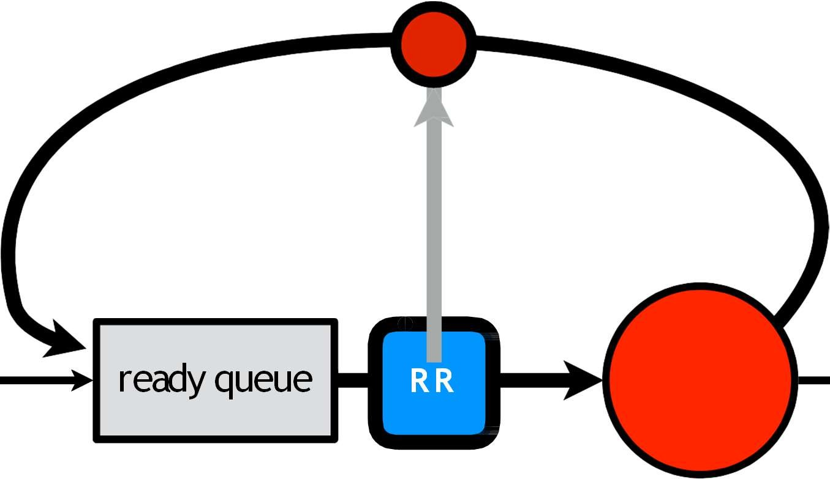

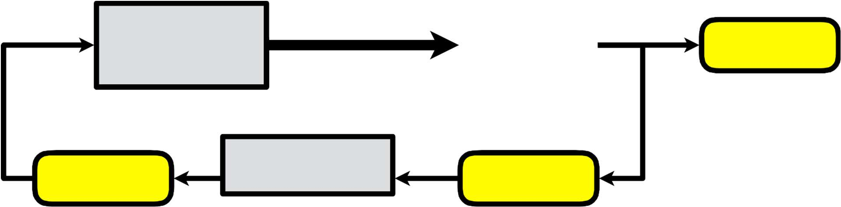
Round Robin (RR)
Round Robin (RR) is a scheduling algorithm where time slices are assigned to each process in equal portions and in circular order.
T
time slice
ready queue
C PU
process
ready queue R R
termination
I/O event
I/O queue
I/O request
fork a child

Slide 65
Round Robin (RR)
RR is design specially for multitasking and time sharing systems.
It is similar to FCFS scheduling, but preemption is added to switch between processes.
Operating System Concepts – 10th Edition
Silberschatz, Galvin and Gagne ©2018

Slide 66
Round Robin (RR)
How it works:
Ready queue is organized as a FIFO queue of processes
Each process gets a small unit of CPU time (time quantum q), usually 10-100 milliseconds.
After this time has elapsed, the process is preempted and added to the end of the ready queue.
Timer interrupts every quantum to schedule next process
Performance
q large  FIFO
q small  q must be large with respect to context switch, otherwise overhead is too high
Operating System Concepts – 10th Edition
Silberschatz, Galvin and Gagne ©2018

Slide 67
Round Robin (RR)
Process Arrival Time CPU Burst Time
P₁ | 0 | 10
P₂ | 3 | 6
P₃ | 3 | 4
P₄ | 8 | 3
P₅ | 13 | 5
q = 4
Gantt Chart:
P₁ | P₂ | P₃ | P₁ | P₄ | P₂ | P₅ | P₁ | P₅
0
4
8
12
16
19 21
25 27 28
Avg Waiting Time = ¹⁷ ⁺ ¹²⁺ ⁵ ⁺ ⁸⁺¹⁰ =10.14
5
Operating System Concepts – 10th Edition
Silberschatz, Galvin and Gagne ©2018

Slide 68
Round Robin (RR)
The average waiting time under the RR policy is often long.
Performance
q large  FIFO
q small  processor sharing equally between all the processes (completely fair!)
q must be large with respect to context switch, otherwise overhead is too high
(in theory) creates the appearance that each of n processes has its own processor running at 1/n the speed of the real processor.
But q must be large compare to context switch, otherwise overhead is too high (q usually 10ms to 100ms, context switch < 10 µsec)
Operating System Concepts – 10th Edition
Silberschatz, Galvin and Gagne ©2018

Slide 69
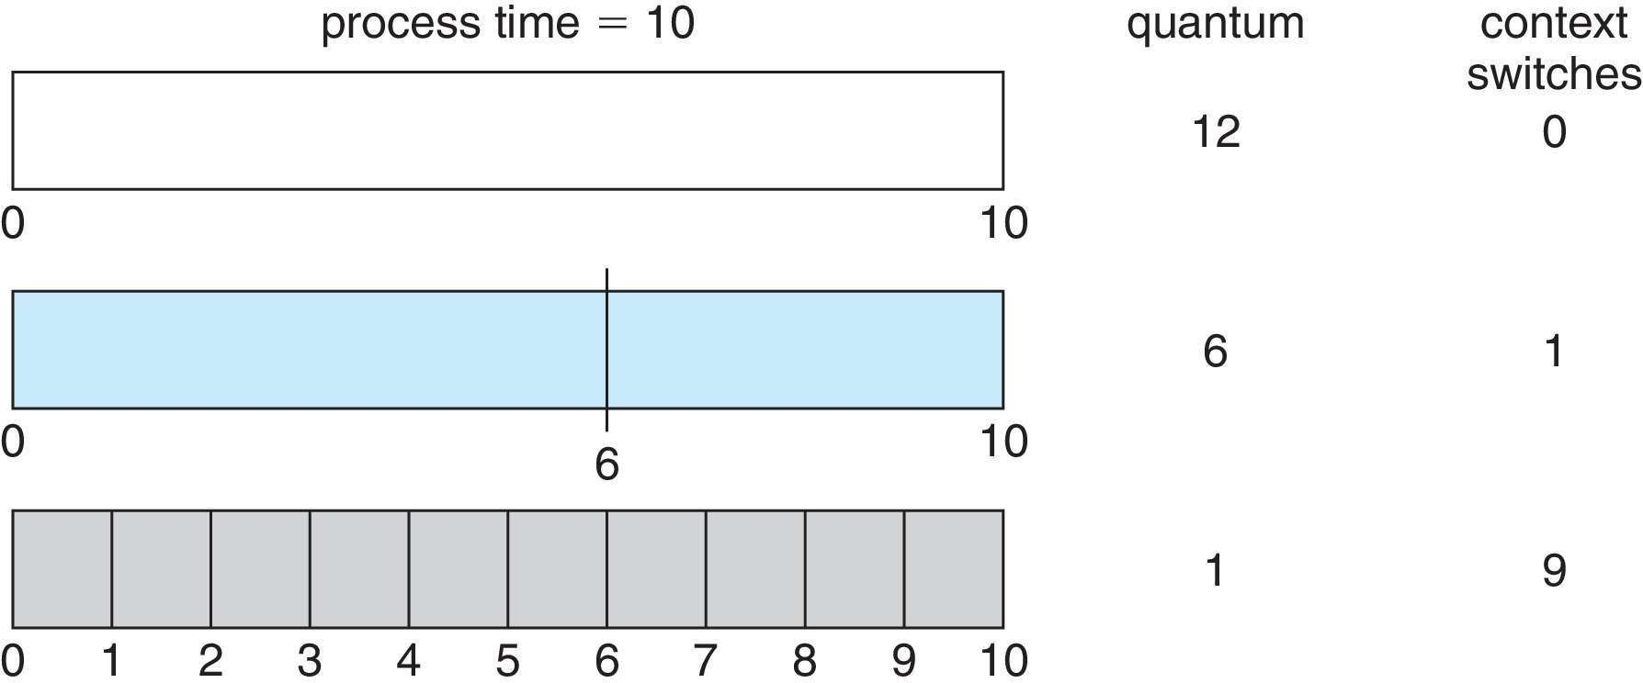
Time Quantum and Context Switch Time
Operating System Concepts – 10th Edition
Silberschatz, Galvin and Gagne ©2018

Slide 70
Practice
P₁ | 0 | 5
P₂ | 1 | 3
P₃ | 3 | 6
P₄ | 5 | 1
P₅ | 6 | 4

Slide 71
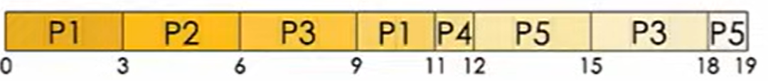
Practice
P₁ | 0 | 5
P₂ | 1 | 3
P₃ | 3 | 6
P₄ | 5 | 1
P₅ | 6 | 4

Slide 72
Finalizing CPU Scheduling Algorithms

Slide 73
Starvation vs Convoy Effect
Starvation happens when a process is perpetually (Permanently) denied the resources it needs to proceed, usually due to scheduling policies that favor other processes. This can prevent a process from ever getting the CPU time or resources it requires.
Consider a print job system where high-priority jobs are constantly queued ahead of a low-priority job. If new high-priority jobs keep arriving, the low-priority job may never get printed, as it continuously waits behind higher-priority tasks. This leads to starvation of the low-priority job.

Slide 74
Starvation vs Convoy Effect
In the Convoy Effect, the entire system slows down because of a few slow processes.
Starvation occurs when a process or service is not being served, even when there is no deadlock on the system.
Convoy Effect involves a group of processes being held back by one slow process, while Starvation involves one process being consistently overlooked in favor of others.

Slide 75
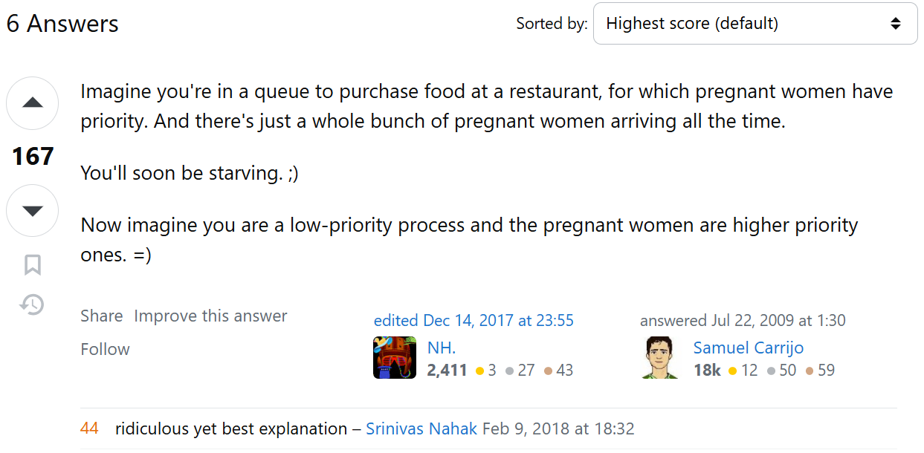
Starvation vs Convoy Effect
theory - What is starvation? - Stack Overflow
https://stackoverflow.com/questions/1162587/what-is-starvation

Slide 76
Priority Scheduling
A priority number (integer) is associated with each process
The CPU is allocated to the process with the highest priority (smallest integer Ξ
highest priority or higher the number higher the priority)
Preemptive
Non-preemptive
SJF is priority scheduling where priority is the inverse of predicted next CPU burst time
Problem Ξ Starvation
low priority processes may never execute
Solution Ξ Aging – as time progresses increase the priority of the process
Operating System Concepts – 10th Edition
Silberschatz, Galvin and Gagne ©2018

Slide 77
Priority Scheduling (non-preemptive)
Process |  | Arrival Time | CPU Burst Time | Priority
P₁ |  | 0 | 10 | 4
P₂ |  | 3 | 6 | 2
P₃ |  | 3 | 4 | 5
P₄ |  | 8 | 3 | 3
P₅ |  | 13 | 5 | 1
Gantt Chart:
P₁ | P₂ | P₅ | P₄ | P₃
10
16
21
24
28
0 + 7 + 21 + 13 + 3
Avg Waiting Time =
= 8.8
5

Slide 78
Priority Scheduling (preemptive)
Process |  | Arrival Time | CPU Burst Time | Priority
P₁ |  | 0 | 10 | 4
P₂ |  | 3 | 6 | 2
P₃ |  | 3 | 4 | 5
P₄ |  | 8 | 3 | 3
P₅ |  | 13 | 5 | 1
Gantt Chart
P₁ | P₂ |  | P₄ | P₁ | P₅ | P₁ | P₃
3
8 9
12 13
18
24
28
14 + 0 + 21 + 1 + 0
Avg Waiting Time =
= 7.2
5

Slide 79
End of Chapter 5, Really 🤔??
Operating System Concepts – 10th Edition
Silberschatz, Galvin and Gagne ©2018

Slide 80
Multilevel Queue
Ready queue is partitioned into separate queues
foreground (interactive)
background (batch)
The processes are permanently assigned to one queue, generally based on some property
Each queue has its own scheduling algorithm:
Foreground: RR
Background: FCFS
Scheduling must be done between the queues:
Fixed priority preemptive scheduling
Possibility of starvation.
Time slice – each queue gets a certain amount of CPU time which it can schedule amongst its processes; i.e., 80% to foreground in RR 20% to background in FCFS

Slide 81
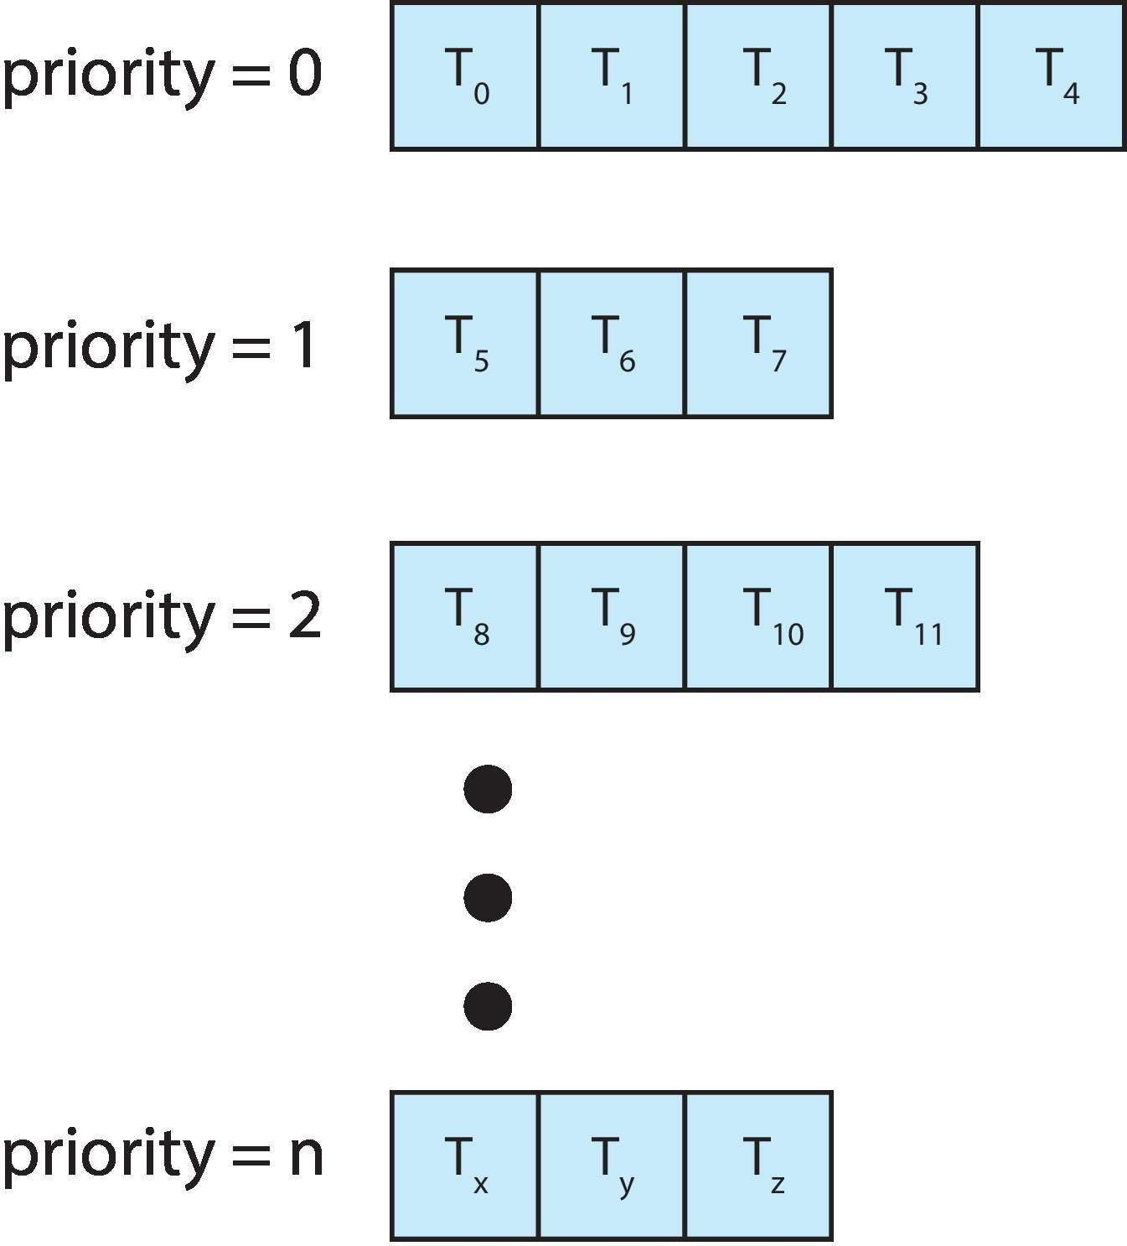
Multilevel Queue
With priority scheduling, have separate queues for each priority.
Schedule the process in the highest-priority queue!
Operating System Concepts – 10th Edition
5.67
Silberschatz, Galvin and Gagne ©2018

Slide 82
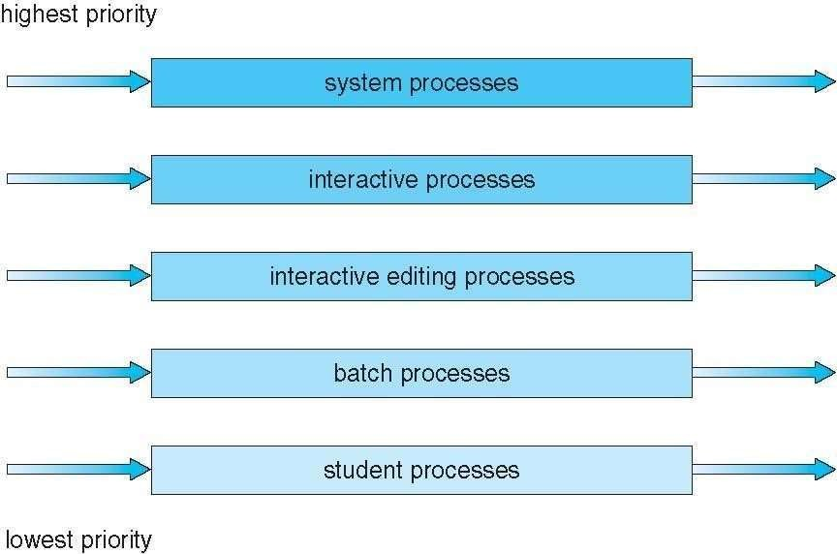
Multilevel Queue

Slide 83
Multilevel Feedback Queue
A process can move between the various queues.
Multilevel-feedback-queue scheduler defined by the following parameters:
Number of queues
Scheduling algorithms for each queue
Method used to determine when to upgrade a process
Method used to determine when to demote a process
Method used to determine which queue a process will enter when that process needs service
Aging can be implemented using multilevel feedback queue
Operating System Concepts – 10th Edition
Silberschatz, Galvin and Gagne ©2018

Slide 84
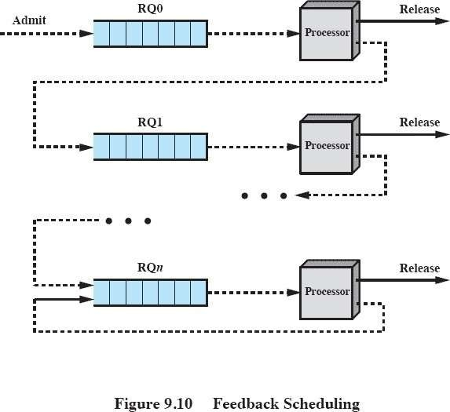
Multilevel Feedback Queue
A method to handle STRAVATION
System Process is keep coming, the normal process will be pushed back
Penalize jobs that have been running longer
Example
Three queues:
RQ₀ – RR with time quantum 8 milliseconds
RQ₁ – RR time quantum 16 milliseconds
RQ₂ – FCFS

Slide 85














Multilevel Feedback Queue
RR (q=8 ms)
CPU
RR (q=16 ms)
CPU
RR (q=32 ms)
CPU
FCFS
CPU

Slide 86
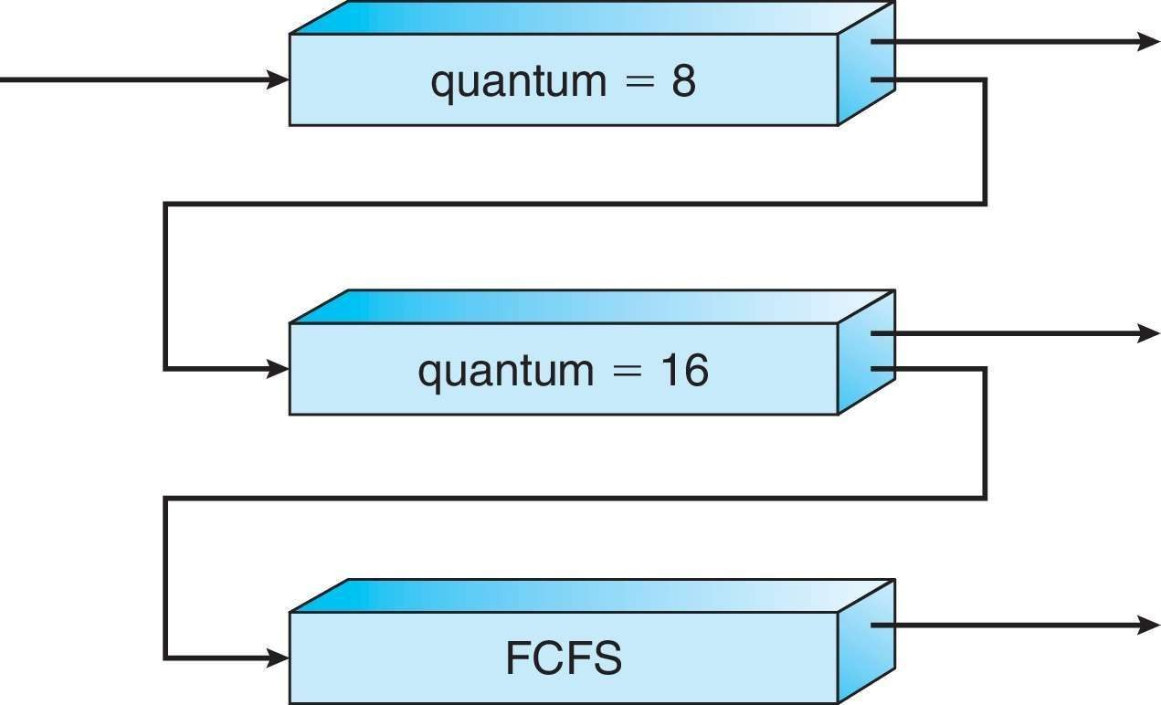
Example of Multilevel Feedback Queue
Three queues:
Q₀ – RR with time quantum 8 milliseconds
Q₁ – RR time quantum 16 milliseconds
Q₂ – FCFS
Scheduling
A new process enters queue Q₀ which is served in RR
When it gains CPU, the process receives 8 milliseconds
If it does not finish in 8 milliseconds, the process is moved to queue Q₁
At Q₁ job is again served in RR and receives 16 additional milliseconds
If it still does not complete, it is preempted and moved to queue Q₂
Operating System Concepts – 10th Edition
Silberschatz, Galvin and Gagne ©2018

Slide 87
Multilevel Feedback Queue
Process |  | CPU Burst Time
P₁ |  | 45
P₂ |  | 20
P₃ |  | 6
Gantt Chart:
P₁ | P₂ | P₃ | P₁ | P₂ | P₁
0
8
16
22
38 50
71
Avg Waiting Time = ²⁶ ⁺ ³⁰ ⁺ ¹⁶ =24
3
Operating System Concepts – 10th Edition
Silberschatz, Galvin and Gagne ©2018

Slide 88
Questions
10
4
2
8
Q1=4ms
Q2=8ms

Slide 89
🙋 Question
Consider a system which has a CPU bound process, which require the burst time of 40 seconds. The multilevel Feed Back Queue scheduling algorithm is used and the queue time quantum '2' seconds and in each level it is incremented by '5' seconds. Then how many times the process will be interrupted and on which queue the process will terminate the execution?
(a) 5,4 (b) 4,5 (c) 3,4 (d) 4,3
https://gateoverflow.in/136284/%23os-%23multilevel-feedback-queue

Slide 90
🙋 Question
Consider a system which has a CPU bound process, which require the burst time of 40 seconds. The multilevel Feed Back Queue scheduling algorithm is used and the queue time quantum '2' seconds and in each level it is incremented by '5' seconds. Then how many times the process will be interrupted and on which queue the process will terminate the execution?
Process P needs 40 Seconds for total execution.
Multilevel Feedback queue:
Queue1 = 2
Queue2 = 7 (2+5)
Queue3 = 12 (7+5)
Queue4 = 17 (12+5)
Queue5 = 2 (left time)
In summary, process is interrupted 4 times, and on 5th queue process completed its execution.
Hence, (b) is correct option

Slide 91
🙋 Question
Consider a system with three processes having the following burst times:
Process P1: 30 seconds
Process P2: 20 seconds
Process P3: 10 seconds
The MLFQ scheduling algorithm is used with the following time quantum structure:
Q1: 5 seconds
Q2: 10 seconds
Q3: 15 seconds
If all processes arrive at the same time, determine:
How many times each process will be interrupted?
In which queue will each process complete its execution?

Slide 92
🙋 Question
Consider a system with three processes having the following burst times:
Process P1: 30 seconds
Process P2: 20 seconds
Process P3: 10 seconds
The MLFQ scheduling algorithm is used with the following time quantum structure:
Q1: 5 seconds
Q2: 10 seconds
Q3: 15 seconds
If all processes arrive at the same time, determine:
How many times each process will be interrupted?
In which queue will each process complete its execution?
Arrivals at Queues:
P1: 3 times (Q1, Q2, Q3)
P2: 3 times (Q1, Q2, Q3)
P3: 1 time (Q1,Q2)
Interrupts:
P1: 3 times (Q1, Q2)
P2: 3 times (Q1, Q2)
P3: 1 time (Q1)
Completion in Queues:
P1: Q3
P2: Q3
P3: Q2

Slide 93
Questions
Consider a system which has a CPU bound process, which require the burst time of 37 seconds. The multilevel Feed Back Queue scheduling algorithm is used and the queue time quantum ‘1' seconds and in each level it is incremented by ‘3' seconds. Then how many times the process will be interrupted and on which queue the process will terminate the execution?

Slide 94
🙋 Question
A system contains a CPU-bound process that requires a burst time of 50 seconds. The MLFQ scheduling algorithm is configured with:
Q1: Time quantum = 3 seconds
Q2: Time quantum = 6 seconds
Q3: Time quantum = 12 seconds
Calculate:
How many times will the process be interrupted during execution?
Which queue will the process terminate in?

Slide 95
🙋 Question
In a scenario with four processes:
P1: 25 seconds
P2: 15 seconds
P3: 35 seconds
P4: 5 seconds
Using an MLFQ scheduling algorithm with the following time quantums:
Q1: 4 seconds
Q2: 8 seconds
Q3: 16 seconds
Assuming all processes arrive simultaneously, answer:
How many total interruptions will occur?
Which processes will finish in each queue?

Slide 96
🙋 Question
Consider a system where a process has a burst time of 60 seconds and the MLFQ scheduling algorithm is set up as follows:
Q1: Time quantum = 7 seconds
Q2: Time quantum = 14 seconds
Q3: Time quantum = 21 seconds
Determine:
The number of interruptions the process will experience.
The queue in which the process will complete its execution.

Slide 97
🙋 Question
A multitasking system runs three processes:
P1: 50 seconds (CPU-bound)
P2: 10 seconds (I/O-bound)
P3: 30 seconds (CPU-bound)
The MLFQ algorithm has these configurations:
Q1: Time quantum = 6 seconds
Q2: Time quantum = 12 seconds
Q3: Time quantum = 18 seconds
Given that P2 is expected to complete quickly, analyze:
How many interruptions will each process face?
In which queues will each process finish its execution?

Slide 98
End of Chapter 5
Operating System Concepts – 10th Edition
Silberschatz, Galvin and Gagne ©2018

Slide 99
Algorithm Evaluation
How do we select a CPU scheduling algorithm for a particular system?
Deterministic Modeling
takes a particular predetermined workload and defines the performance of each algorithm for that workload (prev. examples)
Queueing Models
Simulations
Implementation

Slide 100
Queueing Models
Using I/O and CPU burst distribution (exponential, Poisson, …) and also arrival-time distribution, we can compute the average throughput, utilization, waiting time, and so on for most algorithms.
Example: Little’s Formula
n = average queue length
W = average waiting time in queue
λ = average arrival rate into queue – (lowercase lambda)
Little’s law – in steady state, processes leaving queue must equal processes arriving, thus n = λ x W

Slide 101
Simulations
Queueing models are limited and are often only approximations of real systems
Simulations are more accurate
Programmed model of computer system
Clock is a variable
Gather statistics indicating algorithm performance
Data to drive simulation gathered via
Random number generator according to probabilities
Distributions defined mathematically or empirically
Trace tapes record sequences of real events inreal systems

Slide 102
Implementation
Even simulations have limited accuracy
Just implement new scheduler and test in real systems
High cost, high risk
Environments vary

Slide 103
Virtual Round Robin (VRR)
Similar to Round Robin
There is an FCFS auxiliary queue to which processes are moved after being released from an I/O block.
Processes in the auxiliary queue get preference over those in the main ready queue.
When a process is dispatched from the auxiliary queue, it runs no longer than a time equal to the basic time quantum minus the total time spent running (of the last execution, CPU burst) since it was last selected from the main ready queue.

Slide 104
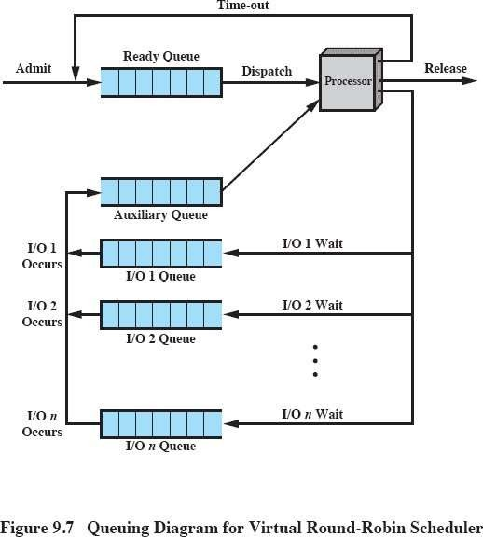
Virtual Round Robin (VRR)

Slide 105
End of Chapter 5
Operating System Concepts – 10th Edition
Silberschatz, Galvin and Gagne ©2018

